Slide 1
The Floyd
A Smart AI CCTV Cam
By: Sekajipo Taplah, Alexander Ge, Rishi Mago, Rudra Patel

Slide 2
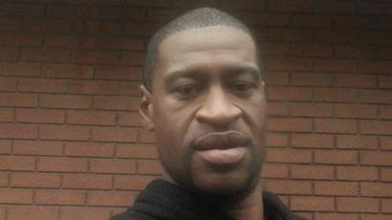
Acknowledgement
This product was made in remembrance of George Floyd. RIP May 25th, 2020

Slide 3
Problem
Store Owners want to keep their establishments safe
Resolve minor conflicts without police
Quick resolutions
Keep track of merchandise

Slide 4
Solution
A Smart AI cam that recognizes conflict and deploys mental health professionals if no lethal weapons are present
Safe tool for both customer and civilians
Quick response time

Slide 5
The Technology

Slide 6
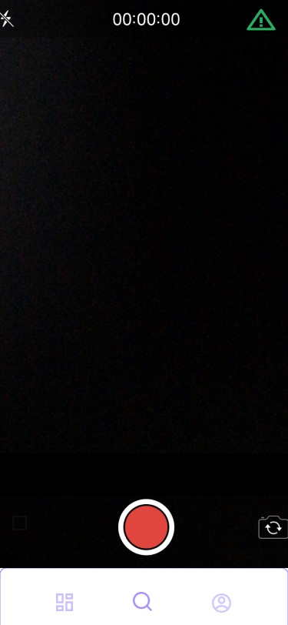
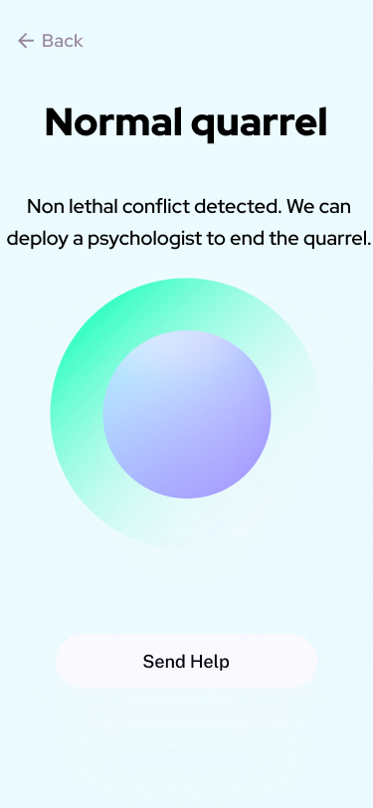
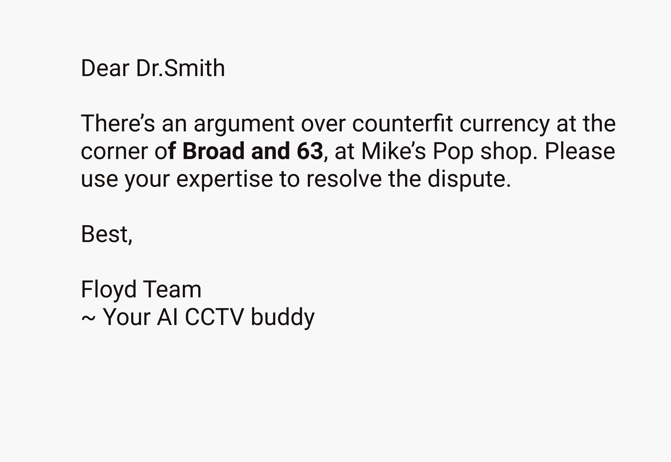
Process Flow

Slide 7
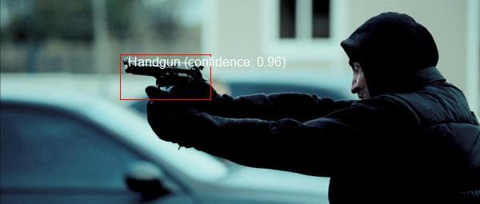
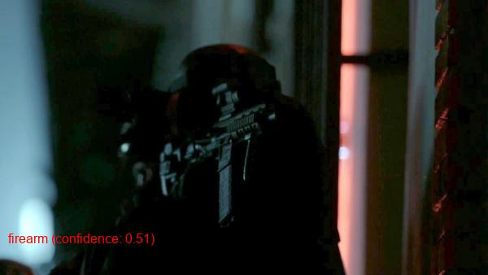
Backend Technology
Each image (representing an individual video frame) is run through two layers of models using Google’s Cloud Vision API
The first identifies the presence of weapons in an image, locates them within the image, and labels them. However, it suffers from low sensitivity
The second identifies and labels weapons with higher sensitivity (allowing improved detection even in dark areas or lower quality images) but is unable to locate them within the image

Slide 8
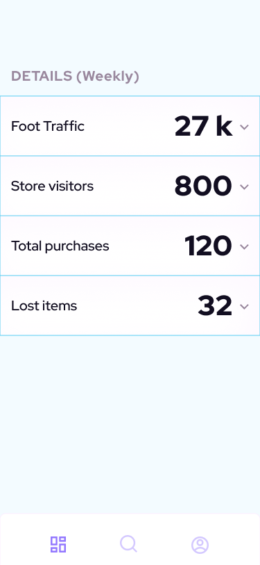
Other uses of the Floyd
Store front foot traffic analytics
Daily Store visitor data
Lost Items tracking

Slide 9
Thank you !

